Slide 1
Agriculture and the Rural U.S. (Part 2)
Hannah Whitley
PhD Student, Rural Sociology
Pennsylvania State University

Slide 2
Today’s agenda
The Great Depression and a New Deal for Agriculture, 1930-1939
World War II and its Aftermath
The Third Agricultural Revolution (“Green Revolution”), 1950 - late 1960s
Post-Green Revolution Paradigm Shifts
Farming in the 21st Century
Persistence of the family farm
Profile of contemporary farmers
Looking to the future

Slide 3
Recap from Monday
In 1800, it took more than 50% of human labor worldwide to procure food
Farmers devoted much U.S. cropland to non-food crops – mainly tobacco – before 1800
But very slowly, with each passing decade, farming became “more efficient” through a combination of human chattel enslavement, tenant farming, and mechanization
As a percentage of the total population, farmers began to decline year by year
So… what happened in the 1930s?
At least 90% of the population had some tie to agriculture – even if only part time
Total number of farmers grew very slowly until the 1930s, then began a slow decline

Slide 4
The Great Depression and a New Deal for Agriculture
1930 - 1939

Slide 5
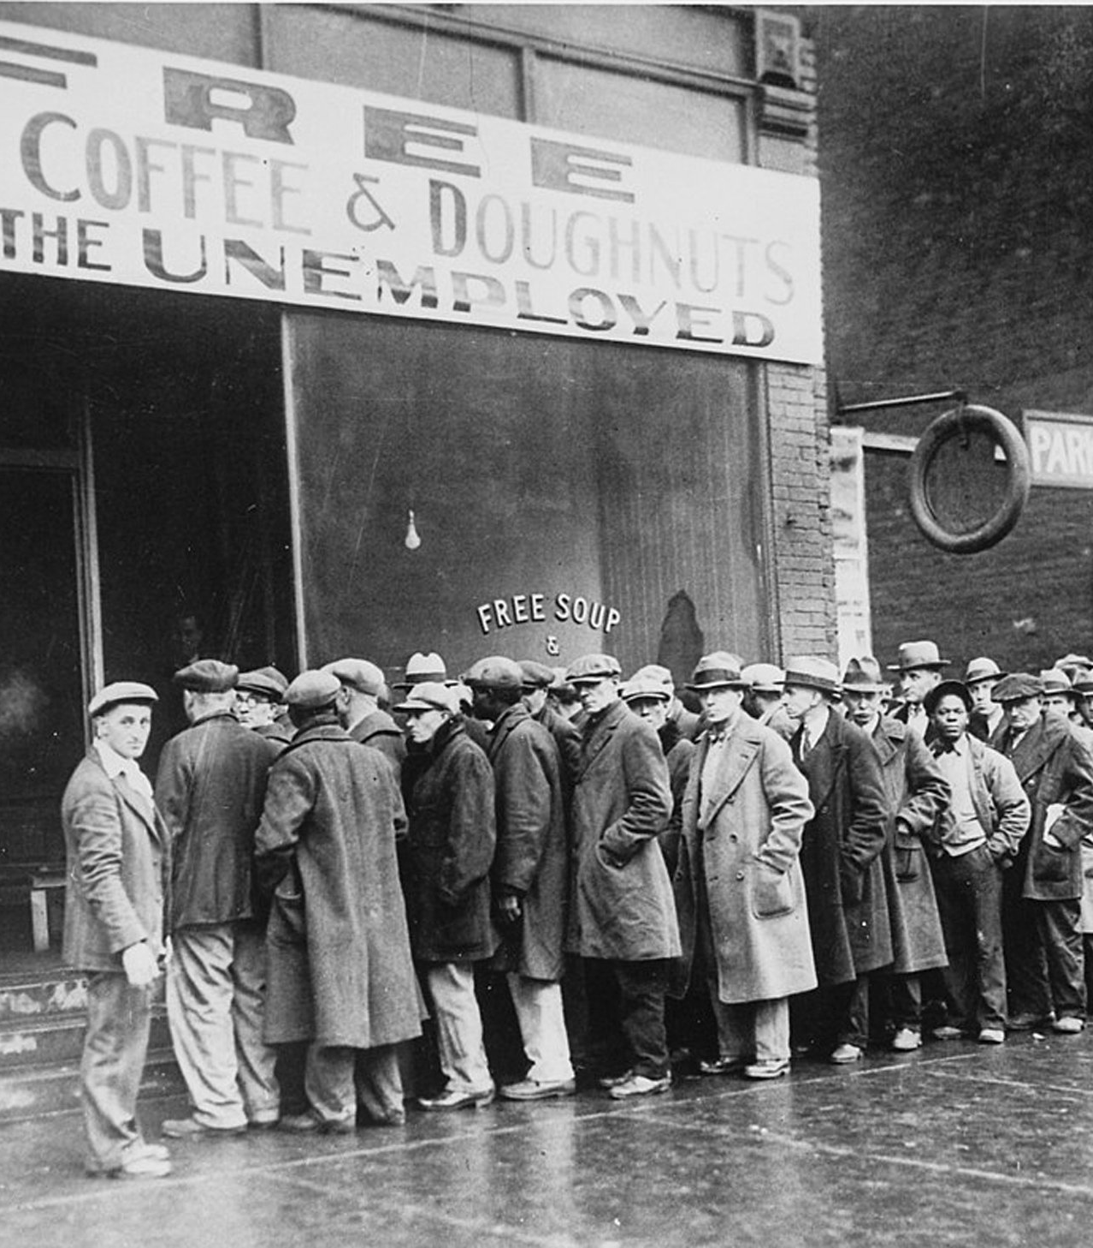
The Great Depression
Although the 1920s appeared to be a prosperous time, income across the U.S. was unevenly distributed
The Great Depression began with the dramatic crash of the stock market on “Black Thursday” – October 24, 1929
Over the next several years, consumer spending and investment dropped, which caused steep declines in industrial output and employment as failing companies laid off workers

Slide 6
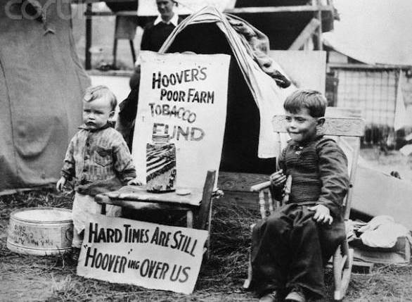
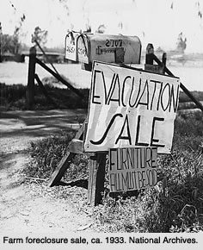
The Great Depression
At the height of the Depression in 1933, nearly 25% of the U.S. total work force (12,830,000 people) were unemployed
Farm prices fell so drastically that many farmers lost their homes and land
In 1930, the average farm was not that different from ones in the late 1800s
Most still used horses and mules
Most only grew one or two money crops (tobacco or cotton)
Food for home still largely came from family farms

Slide 7
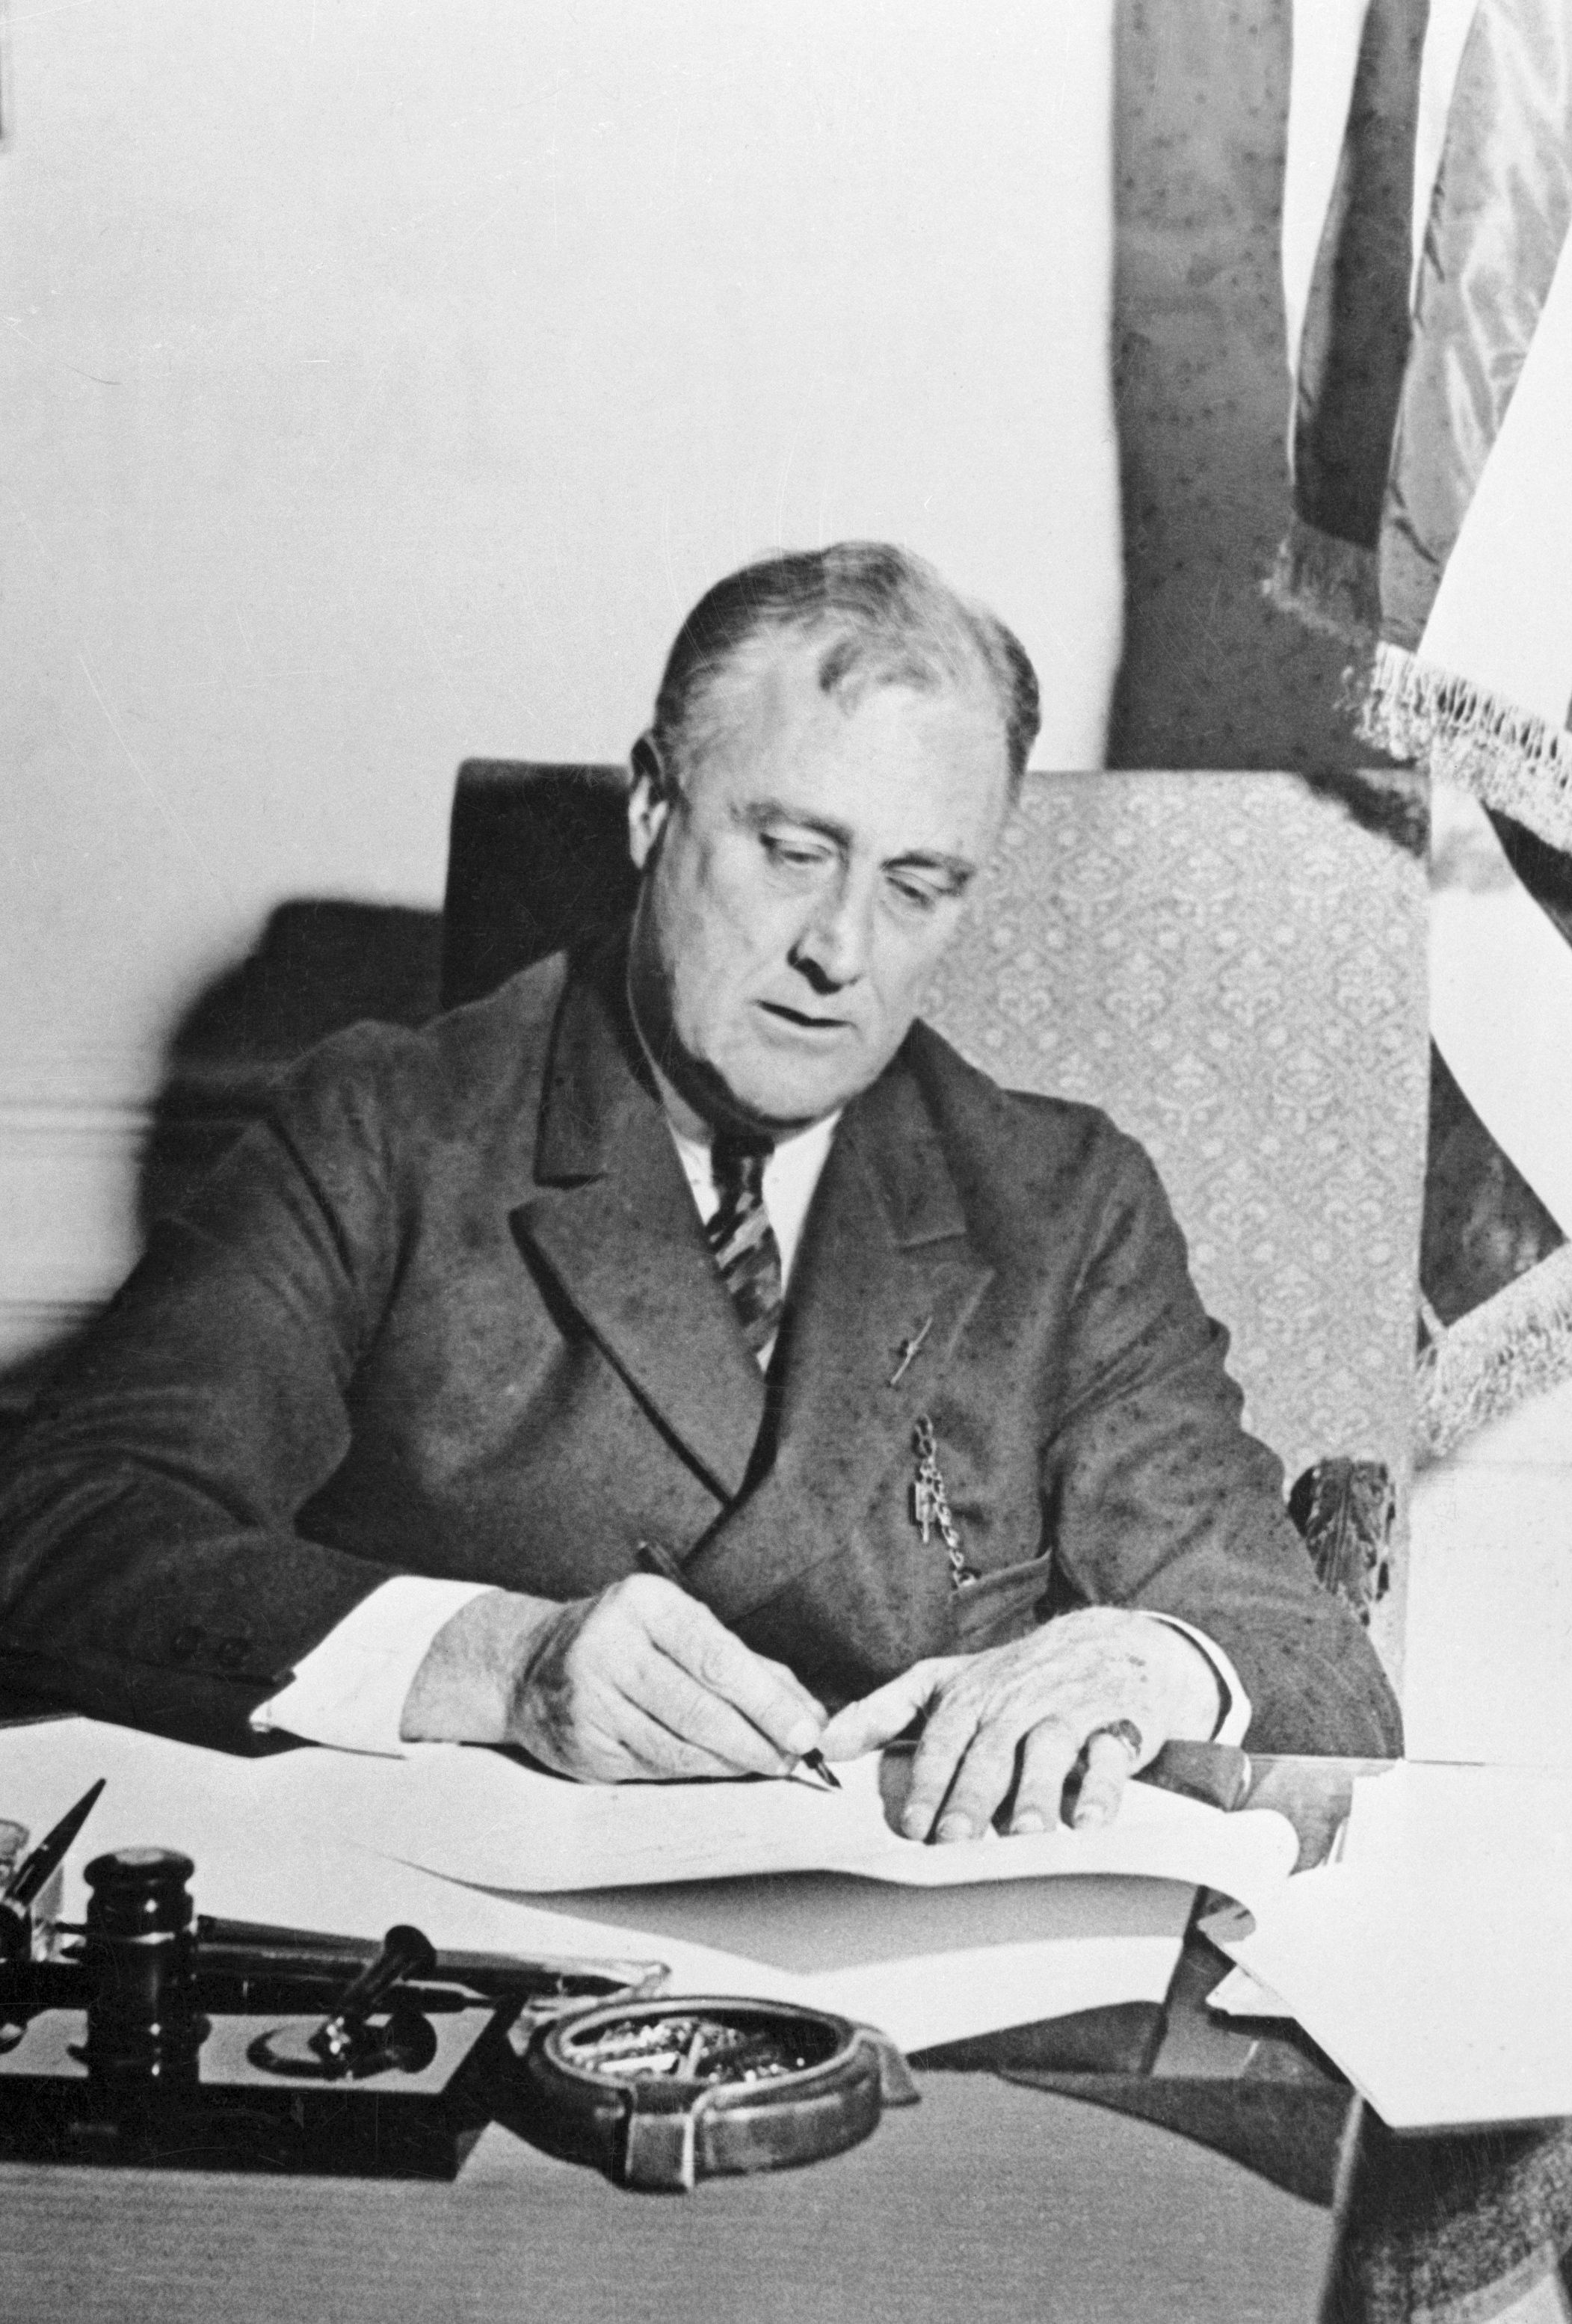
The Great Depression
The Depression necessitated new farm policies, otherwise up to half of U.S. farmers would have suffered bankruptcy (1/4 did) and the overall Depression would have been much more severe
The New Deal, led by President FDR’s administration, brought forth a period of major agricultural legislation and programming by the federal government

Slide 8
Short clip – “The Depression, The Family Farm, and the New Deal”
https://www.youtube.com/watch?v=byAxhrUhjfw&feature=youtu.be

Slide 9
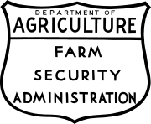
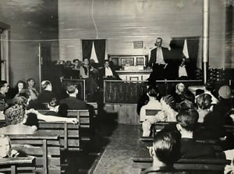
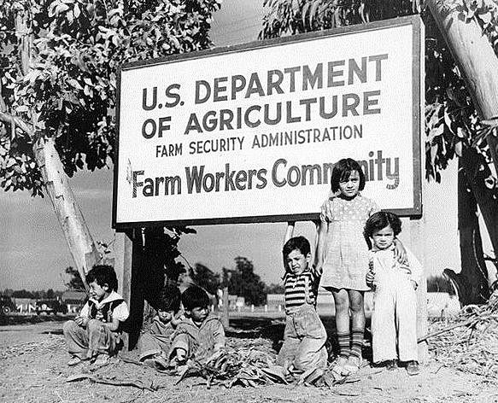
Farm Security Administration (FSA)
Created in 1933 by Roosevelt as part of the New Deal
Goal was to come to the aid of agricultural workers and tenant and family farms
Price supports for six basic commodities: Peanuts, cotton, tobacco, rice, wheat, and corn
Promoted co-ops and provided medical care to poor rural families

Slide 10
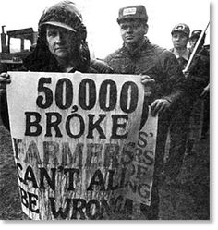
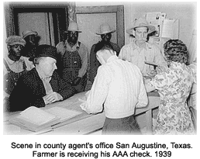
Agricultural Adjustment Act (1933)
Set limits on the size of crops and herds farmers could produce – goal was to stabilize prices at a level at which farmers could survive
Farmers that agreed to limit production were paid a subsidy
Farmers received payments for cutting production and practicing conservation methods

Slide 11
Long-term effects of Depression Era Agriculture Policies
Policies keyed to income based on prior levels of production (pre-DepressiOn), thus helped sustain the gap between large and small farmers
Production controls made it more difficult for small farmers to compete
Larger and more efficient farmers gained the greatest benefits from farm policies
Made entry into farming more and more expensive
Tendency for small, less competitive farmers to leave agriculture
In 1940, the farm population fell to what it had been in 1900 – about 30 million

Slide 12
World War II and its Aftermath
1939 - 1950

Slide 13
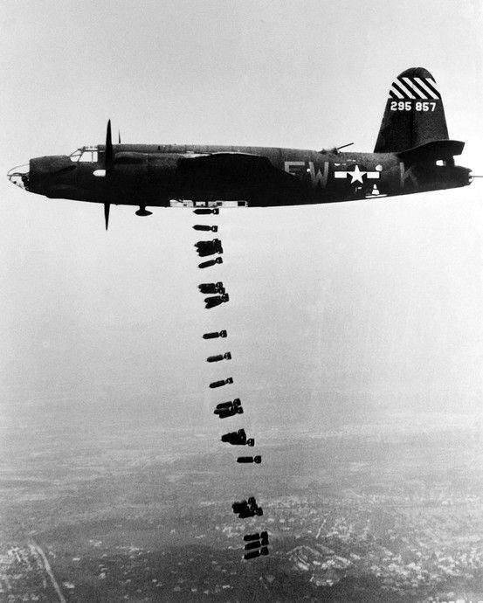
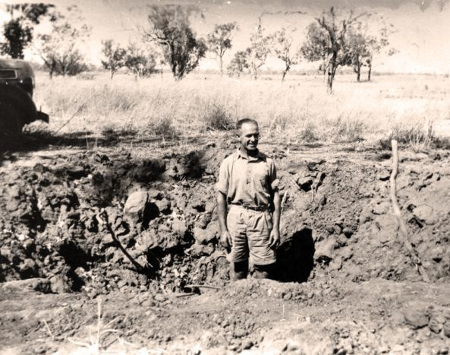
World War II & its Aftermath
1939 – 1945; devastated European economies and destroyed large portions of land used for agriculture
Post-WW2, U.S. companies dominated the market for food exports and farm machinery
Government agricultural policies provided an institutional framework for this growth – how can we provide enough food for the U.S. AND Europe?
Result was an unprecedented level of technological sophistication
New tools required specialized skill, increased amounts of land, and money to power the machines

Slide 14
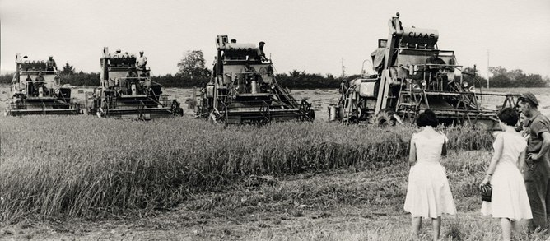
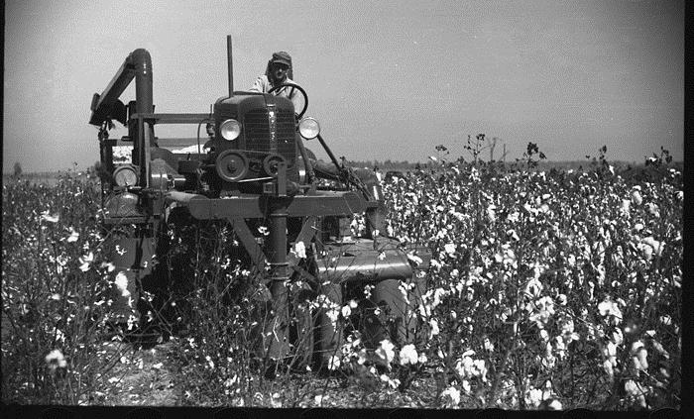
World War II & its Aftermath
Only after 1950 did tractors and self-propelled harvesters fully displace horses
Most significant innovations were the combine and the mechanical cotton picker

Slide 15
The Third Agricultural Revolution
1950 – late 1960s

Slide 16
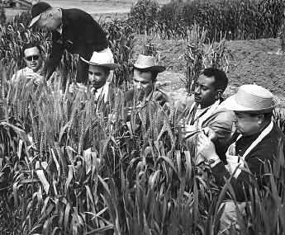
The Third Agricultural Revolution
AKA the “Green Revolution”
A set of research technology education initiatives that aimed to increase agricultural production worldwide, particularly in the Global South
The initiatives resulted in the adoption of new technologies, including:
High-yielding varieties of cereals (esp. wheats and rices)
Chemical fertilizers and agro-chemicals
Controlled water supply (irrigation)
Increased mechanization

Slide 17
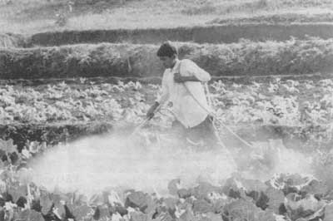
The Third Agricultural Revolution – Socioeconomic impacts?
Transition from traditional ag to Green Revolution agriculture led to the widespread establishment of rural credit institutions
Smaller farmers often went into debt
Increased mechanization on larger farms removed a large source of employment from rural economies
New economic difficulties of smallholder and landless farm workers led to increased rural-urban migration
Increase in global food production led to cheaper food

Slide 18
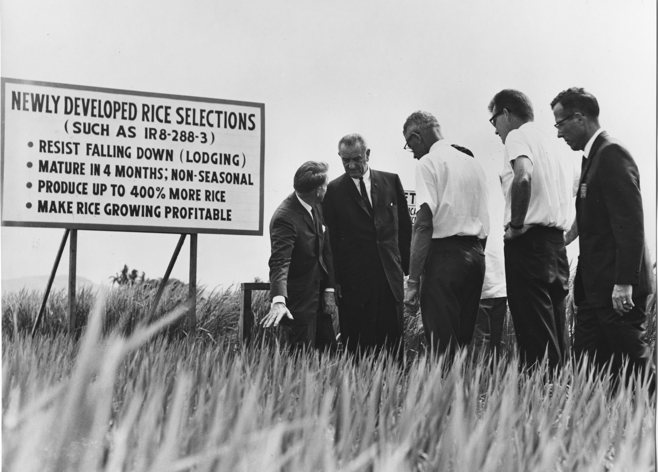
The Third Agricultural Revolution – Environmental impacts?
Effects on agricultural and wild biodiversity – reliance on just a few high-yield varieties of each crop
Concerns about susceptibility to pathogens that cannot be controlled by agro-chemicals
Reliance on a few stable and market profitable crops
Increased greenhouse gas emissions
Dependence on non-renewable resources
Big concern about the unsustainability of agriculture

Slide 19
Post-Green Revolution Paradigm Shifts
1970s - now

Slide 20
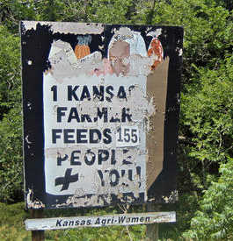
Post-Green Revolution Paradigm Shifts
From 1950 to 1970, U.S. agriculture grew at an astonishing rate
Reduction of the agricultural labor force by approximately 50%
Rapid consolidation of farms
Thousands of small family farms are consolidated into large corporate conglomerates as a result of mechanization and economic policy
“Get big or get out”
Large farms employ almost 2/3rds of all farm laborers – most who only work on a part-time or seasonal basis
Still… the number of farms in the U.S. has remained relatively stable and so has the number of farm operators

Slide 21
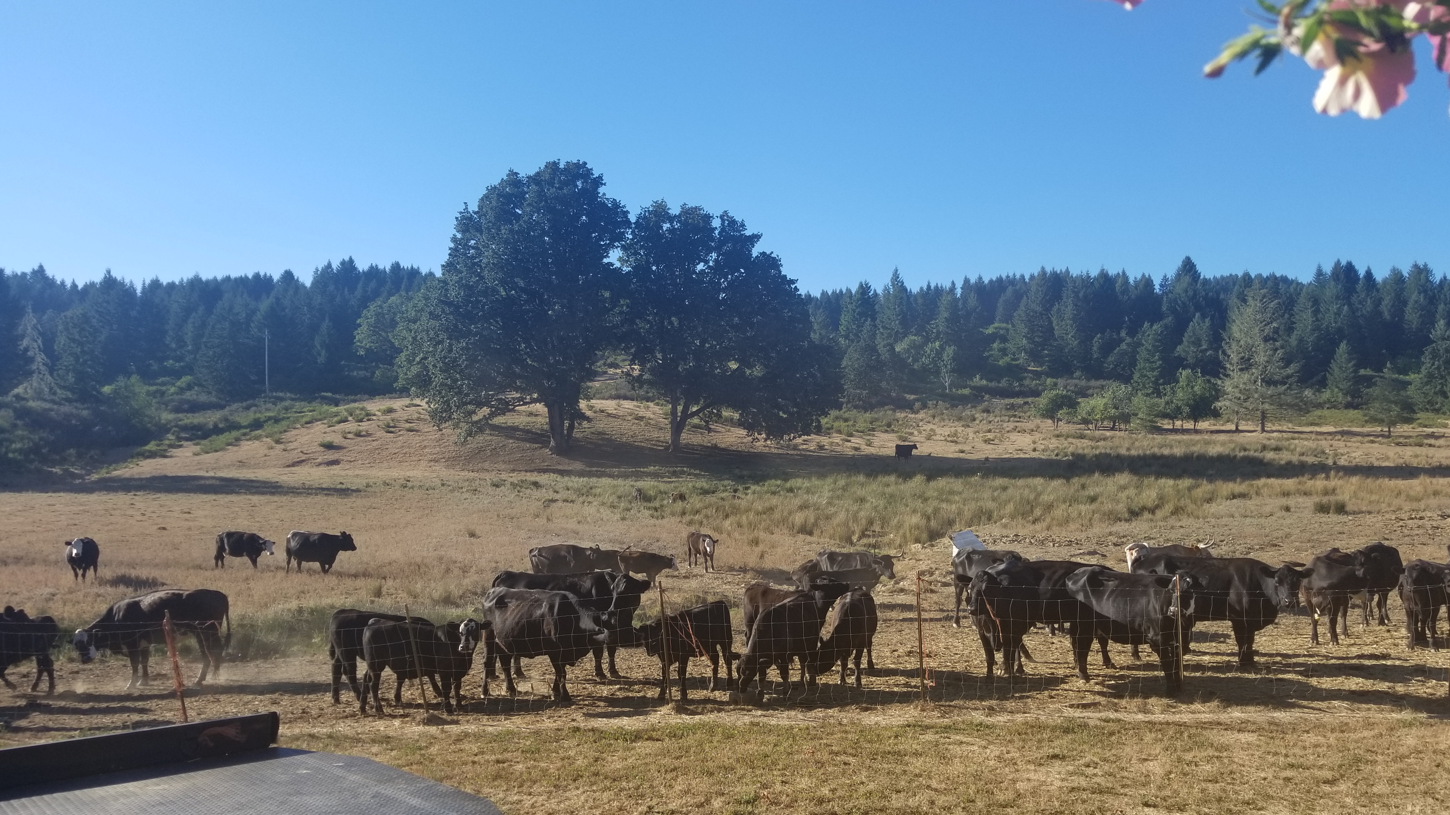
Post-Green Revolution Paradigm Shifts
Structurally, U.S. agriculture is still dominated by family-owned farms
HOWEVER – many families form partnerships or corporations in which the family retains majority ownership
Increasingly closer tie between farmers and agricultural businesses (contract farming)

Slide 22
Why does this consolidation keep happening? Where are the family farms going?
William Cochrane – concept of agricultural treadmills
Idea that farmers are under tremendous economic pressure to adopt new technologies and increase the size of their operations
Logic: (1) Those first to adopt a technology initially experience windfall profits from increased output (2) The effect of the heightened output eventually exerts downward pressure on prices because the market becomes flooded with new product
Those yet to adopt the technology MUST if they wish to remain in the market

Slide 23
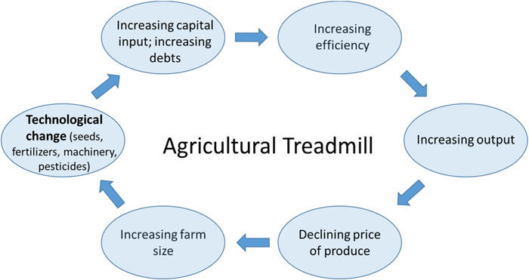
Agricultural Treadmills
Those who have invested in new technologies are essentially running on the spot
However, those who have not yet jumped on the treadmill are left behind – slow to adapt? More likely to “fall off the treadmill”
Continual pressure to adopt the latest technologies and inputs while simultaneously increasing operation scale

Slide 24
Despite this, there are still family farms. Why do they continue to persist?
Some people think that family farms are able to persist because of their willingness to accept lower levels of wages (self-exploitation), which allows them to overcome productivity issues
The Mann-Dickinson thesis REJECTS this argument Argue a structural explanation for why capital-labor relations proceed more slowly in agriculture than in other sectors

Slide 25
The Mann-Dickinson thesis
“Capitalist development appears to stop, as it were, at the farm gate”
There’s something about nature itself that is holding capitalism at bay when it approaches agriculture
Mann and Dickinson identify the following reasons why family farms persist:
Gap between production time and labor time
Unproductive production time
Risks/invariabilities of production
Currently, capitalism does not have the power to literally transform nature
Growing takes time and is at the mercy of time, risks, and invariabilities

Slide 26
Farming in the 21st Century

Slide 27
Brainstorm – Draw a farmer!
Take 5 minutes to draw what you think a farmer looks like while at work
Name at least three characteristics of your farmer
What is their gender?
Race?
Where do they live?
What are they farming?
Are they old? Young?

Slide 28
Profile of Contemporary Farms
U.S. Census of Agriculture, 2017

Slide 29
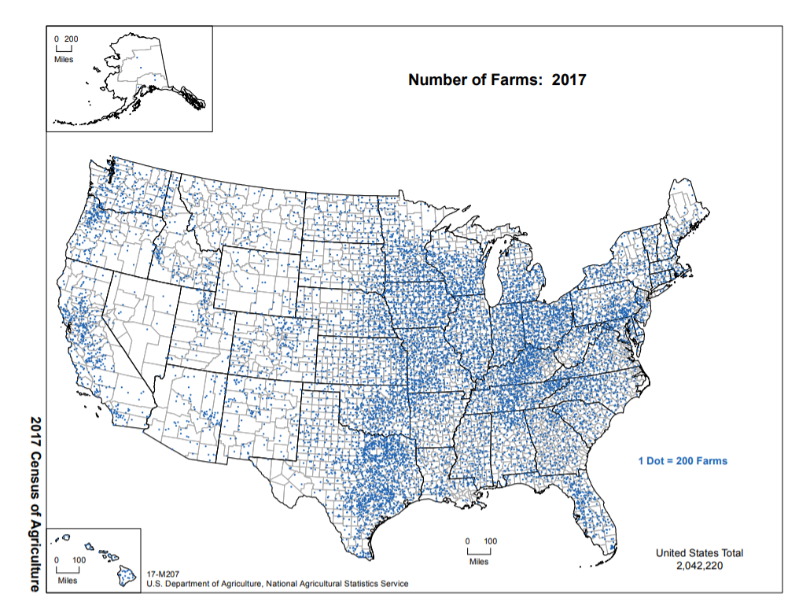
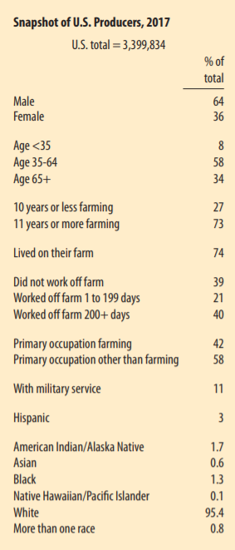

Slide 30
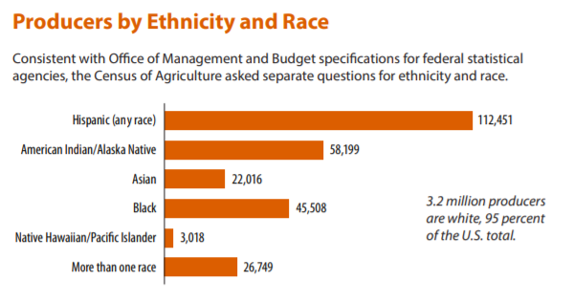

Slide 31
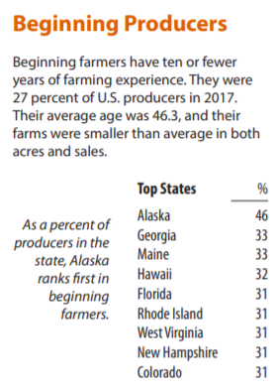
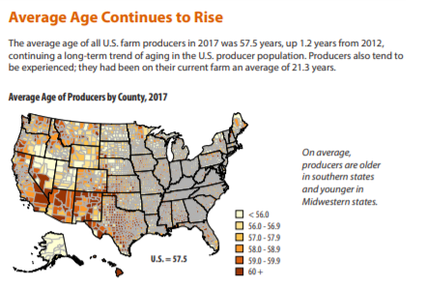

Slide 32
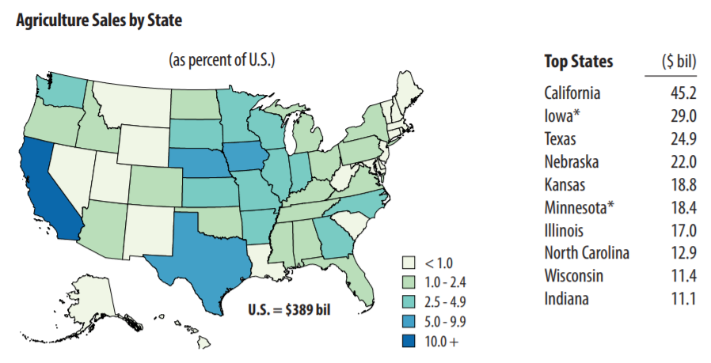
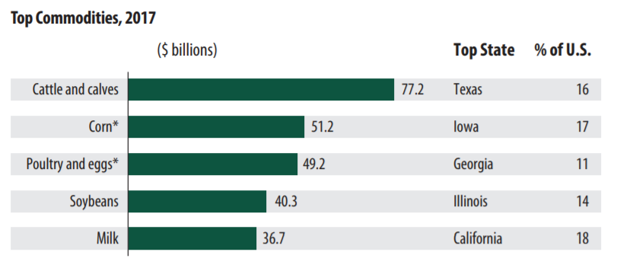

Slide 33
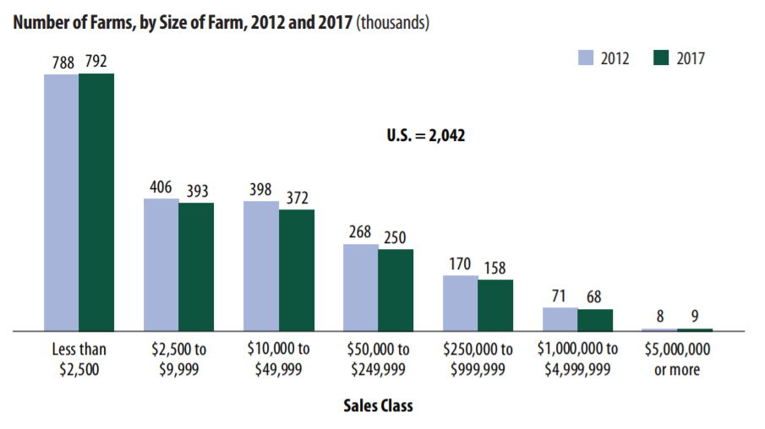
Number of farms owned by non-family investors
Majority of farms in the U.S. are small, operating on annual sales of less than $10,000
In 2018, only 2% of farms were primarily owned by non-family investors
Accounted for 44,010 acres out of a total 2,042,220 farms across the U.S.

Slide 34
Complicating the definition of a “family farm”
On a majority of family farms, the operator does not gain even half of their income from farming
Nearly a fourth of principal operators do not live on farms
Even among full-time operators, some of the largest and wealthiest farmers do not have full managerial control
Many very large family-owned and –operated farms seem more like urban business enterprises than what we might call a traditional farm

Slide 35
Looking to the future

Slide 36
Challenges?

Slide 37
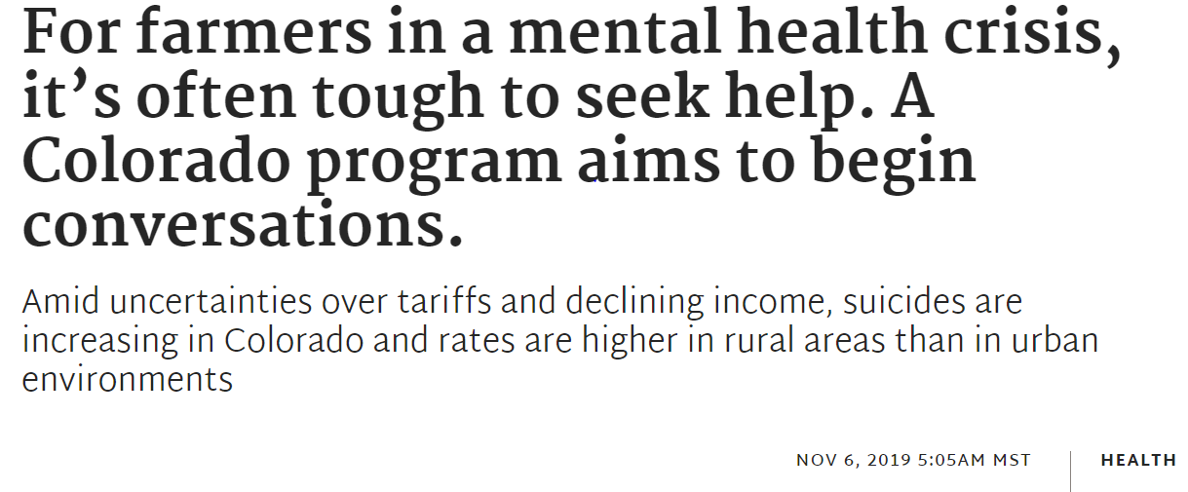
Opportunities?

